Slide 1


Cash Handling Training

Slide 2

Cash Handling
PURPOSE
To ensure that cash handling practices are consistent and transparent across the District.
RATIONALE
Cash transactions are one of the most vulnerable areas of the school. The school will implement the measures outlined in this presentation in accordance with District guidelines to safeguard and protect the staff involved in receipting and collection of monies and minimize the risks associated with cash handling.
AIMS
  Minimize risk and protect sponsors/staff involved in receipting and collection of cash.
  Provide a clear set of cash handling procedures to ensure all cash is receipted and recorded intact and in a timely manner.
  Provide clear understanding of the process and ensure it aligns with District policy and guidelines.

Slide 3
Sponsor/Staff Responsibilities
The Sponsor/Staff of each student organization is responsible for the proper administration of the organization’s funds.
These responsibilities include:
  Safekeeping of the organization’s funds
  Ensuring organization receipts and expenditures are handled in accordance with District policies and procedures
  Oversight of organization fundraisers in compliance with District policies and procedures

Slide 4
Cash receipts
A receipt should be issued for all money collected.
All money must be submitted to the Secretary in the same form as collected. Cash collected may not be used to make purchases or payments of any kind.
Do not co-mingle District and personal funds for any reason.
Money should not be kept unsecured in the classrooms, office or desk or taken home. Collections should be submitted to the Secretary daily. (Exception is made if amount collected is less than $50, it is maintained in a secured location, and submitted by the end of the week).

Slide 5

Receipts
There are several forms of receipts that may be used. Select the form that is most appropriate and efficient.
  Individual Receipts
  Tabulation Receipt Form
  Ticket Receipt Form
  Product Receipt Form

Slide 6

Individual Receipts
Appropriate for large amounts collected.
Triplicate receipt books should be used. (1- original to person making payment, 2 - submitted to Secretary, 3 - remains in the book)
The receipts should be filled out completely.
The receipts should not be pre-dated and pre-signed.
After all receipts are issued, the second copy should be removed from the book and attached to a Deposit Form.
The Deposit Form indicates who is submitting the funds, amount collected, beginning and ending receipt numbers, etc.
The totals per the deposit slips must agree to the total funds submitted to the Secretary.

Slide 7
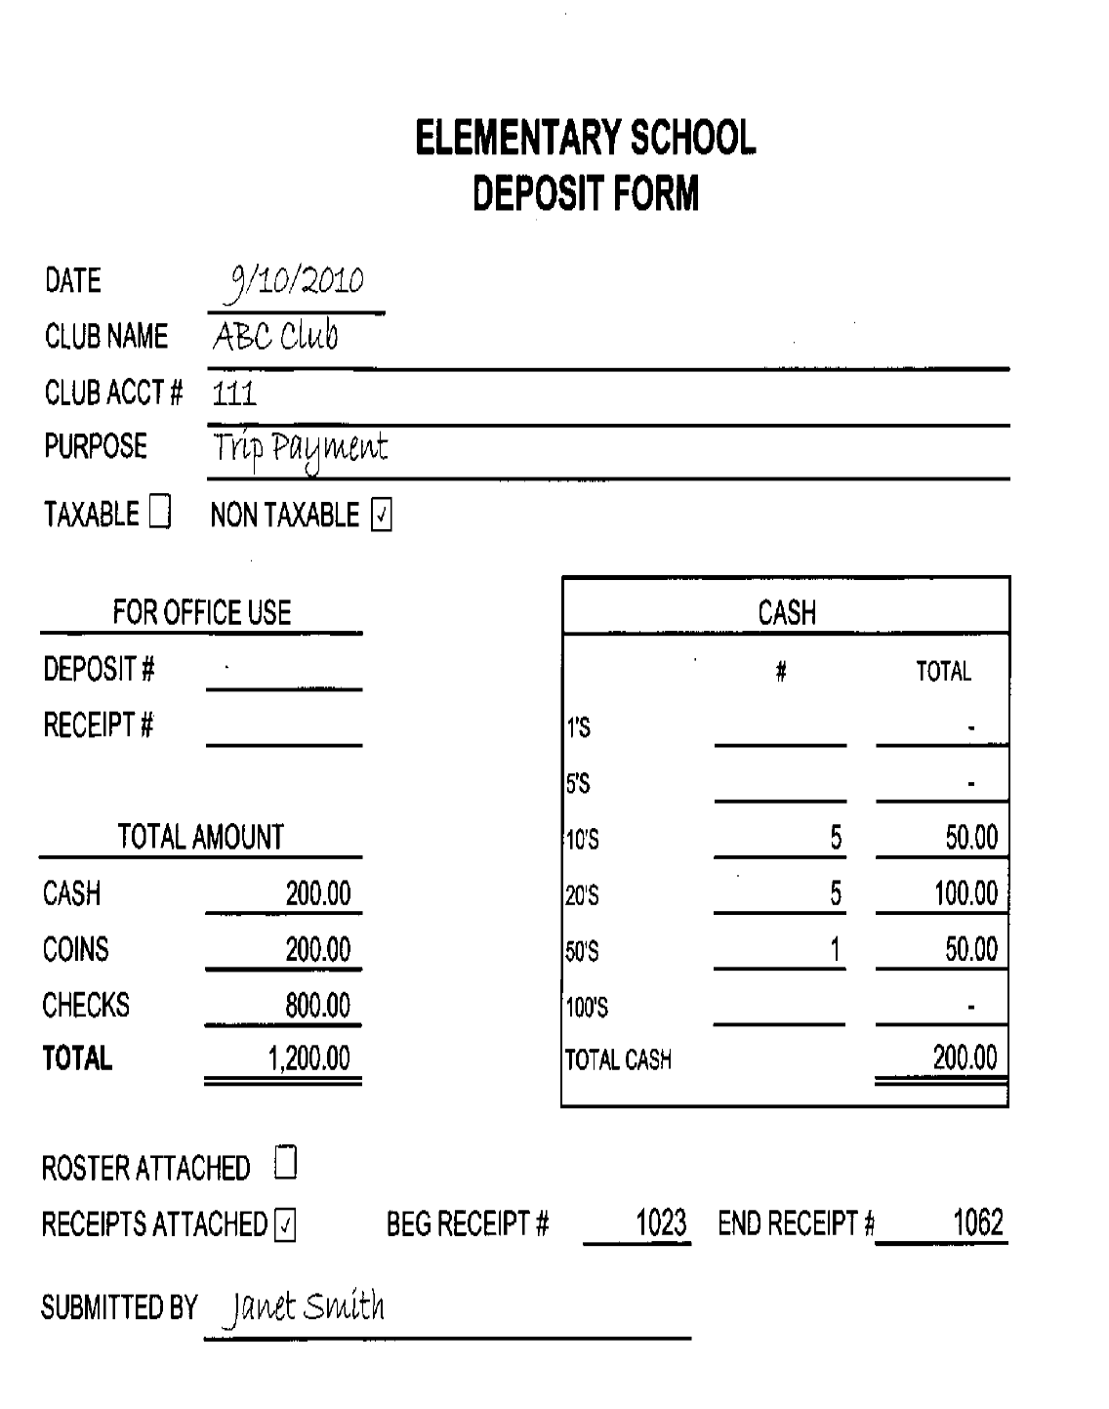
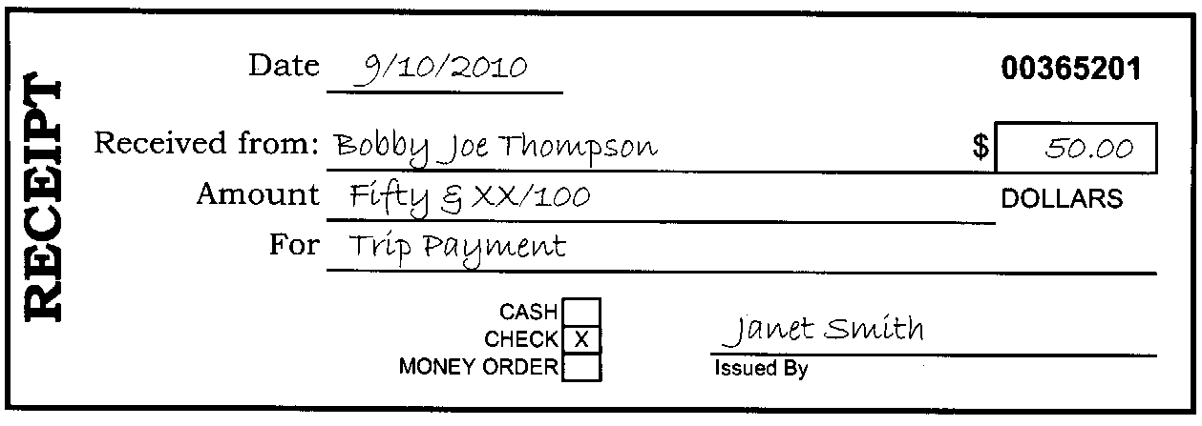
Example Individual Receipts

Slide 8

Tabulation receipt form
Appropriate for high volume of small payments in the same amount.
Incorporates the information in the Deposit Form with the details of the amounts collected into one form.
When funds are collected, payment form (cash or check) are noted along with the name and amount.
The person submitting the funds initials on the line indicating agreement in amount submitted.
The money should be submitted along with the Form to the Secretary. Amounts submitted must agree to the Form.

Slide 9
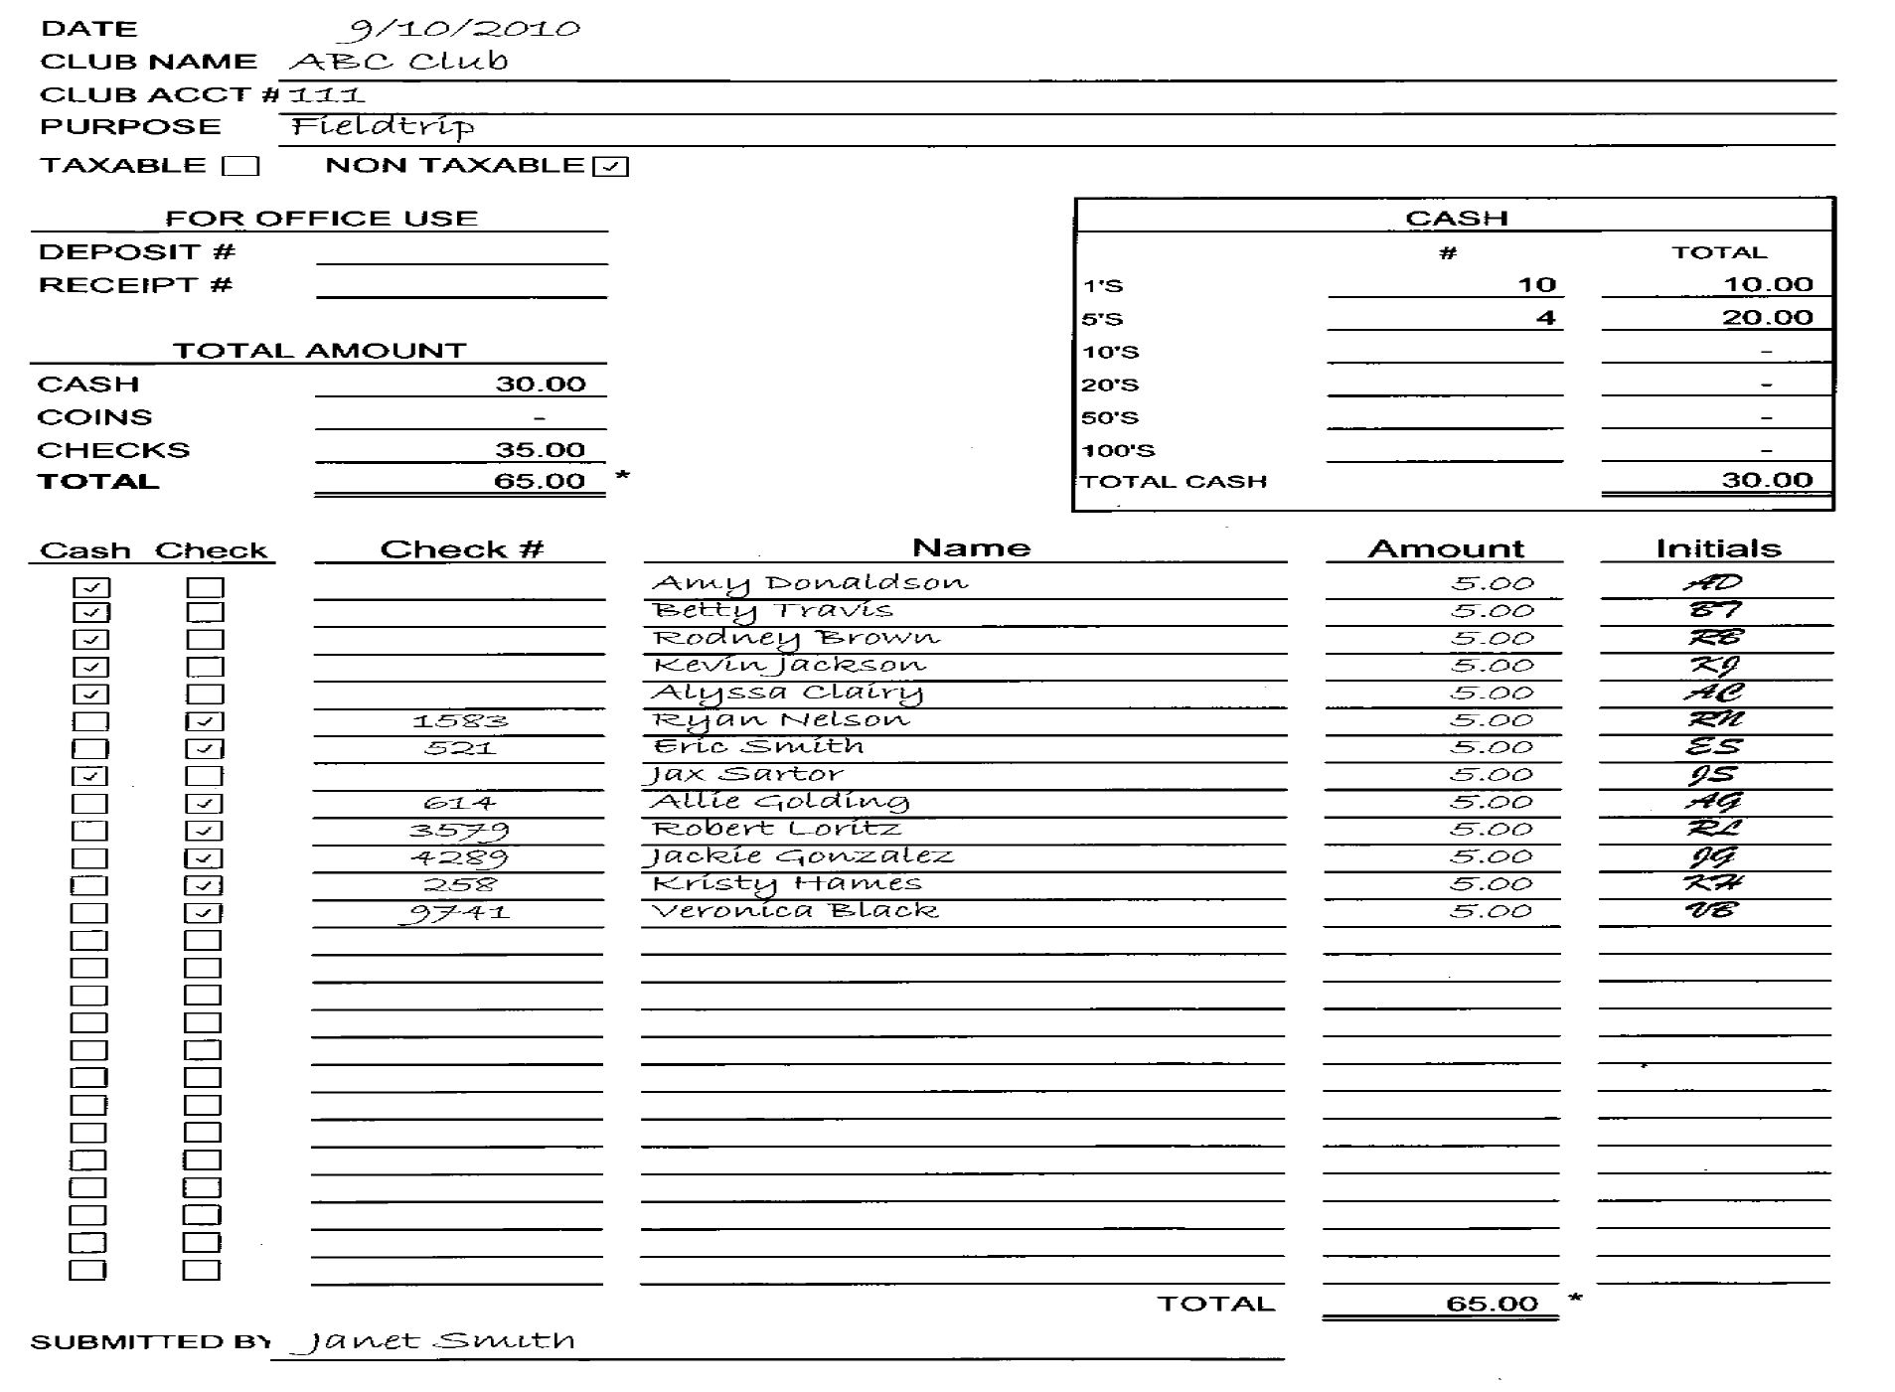

Example tabulation receipt form
Example Tabulation receipt form

Slide 10

Tabulation receipt form
An acceptable alternative to the Tabulation Receipt Form is the use of a class roster.
  Simply print a class roster and notate the amount received from the student next to their name and write the check number if paying by check. The student should initial the sheet if possible.
  Attach a Deposit Form to the roster and submit to the Secretary. (The Deposit Form documents who collected the funds, purpose, etc. for the Secretary to ensure the deposit is recorded to the correct account.)

Slide 11
Product/ticket receipt forms
Appropriate when selling product or issuing tickets.
Calculates the amount you should’ve collected based on beginning and ending product quantities or ticket numbers.
The money should be submitted along with the Form to the Secretary. Amounts submitted must agree to the Form.

Slide 12
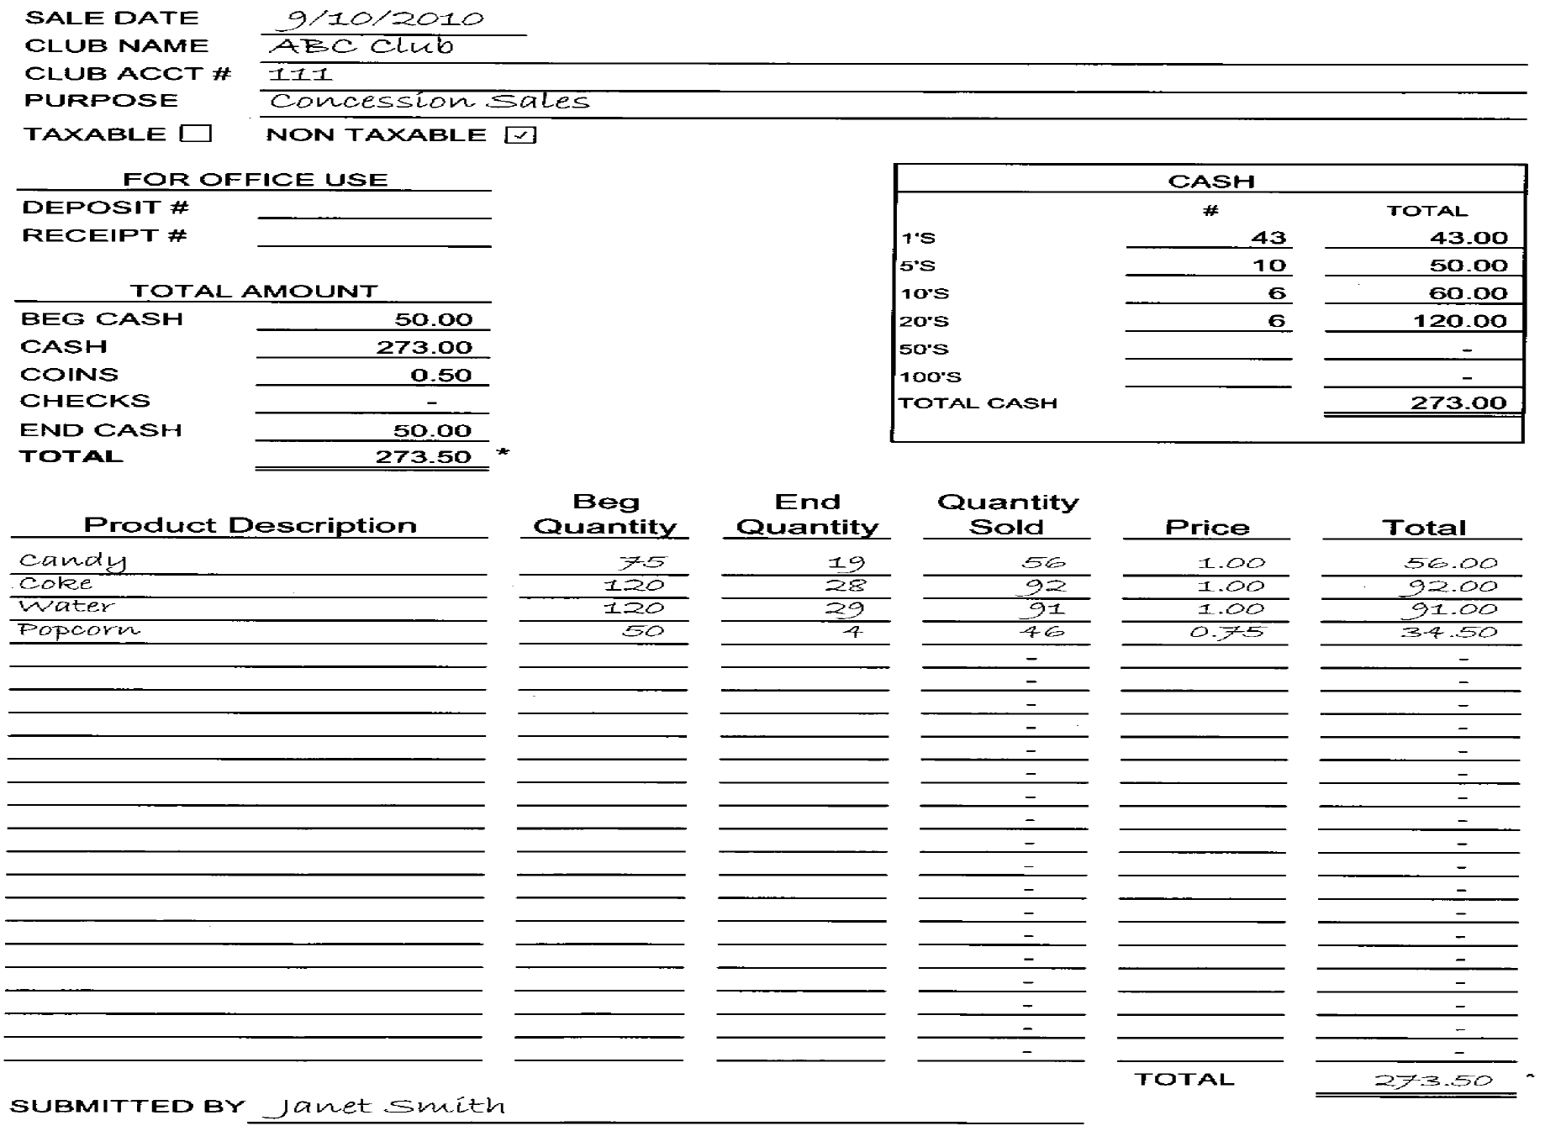

Example product receipt form

Slide 13
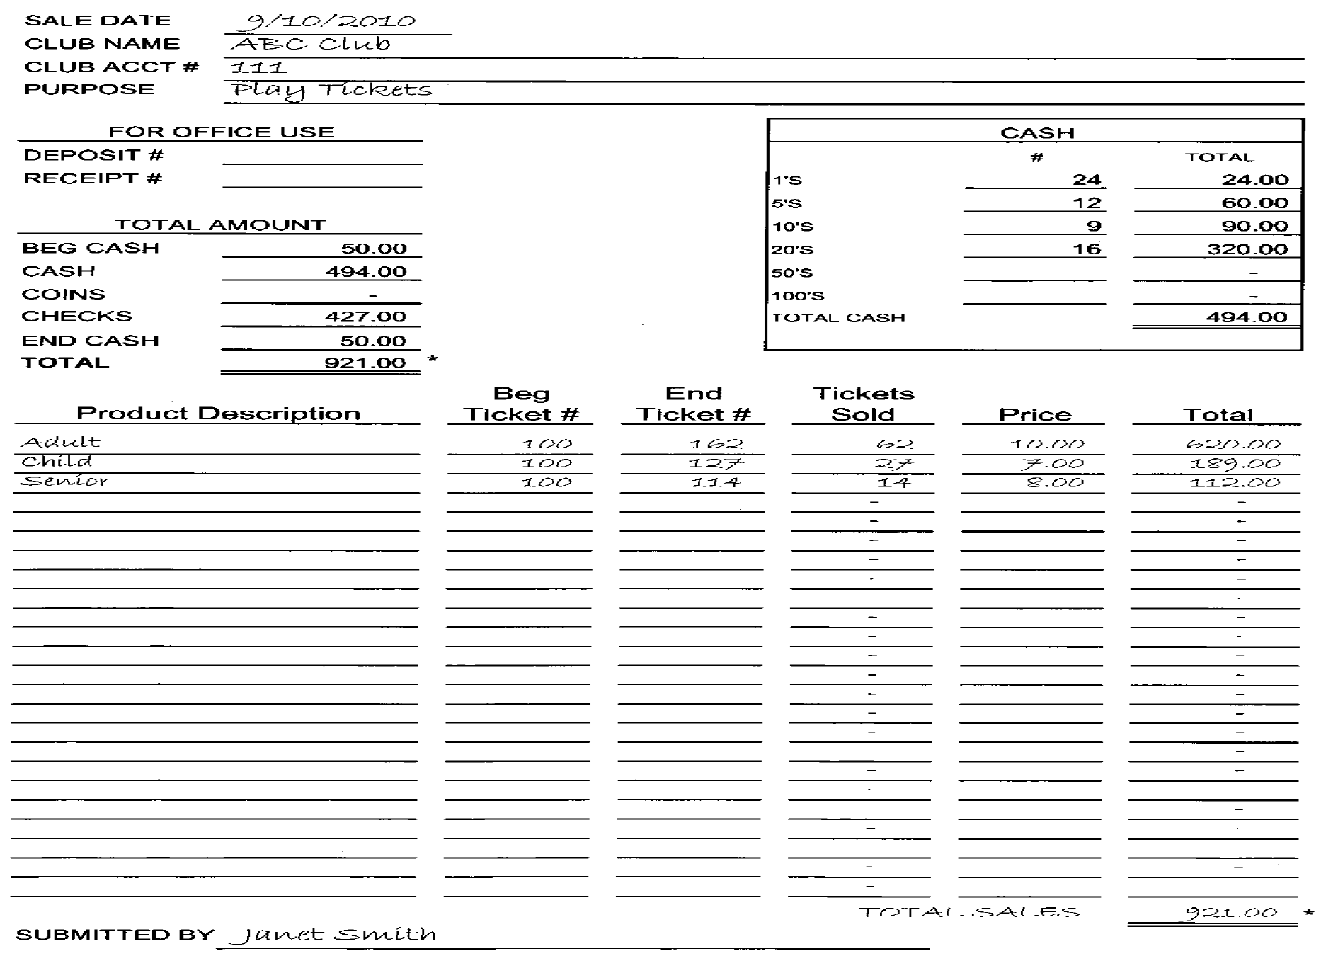
Example ticket receipt form

Slide 14
Submitting to the secretary
All deposit/receipt forms must be filled out completely or they will not be accepted by the Secretary.
All money and supporting forms must be turned into the Secretary and counted in the Staff/Sponsor’s presence.
  DO NOT PUT MONEY ON THE SECRETARIES DESK, CHAIR, ETC.
  Until the time that the Secretary has counted the money in your presence and issued you a receipt for an amount that you both agree on, the money is the Staff/Sponsor’s responsibility.

Slide 15
Conclusion
As a cash handler, you are the face of the organization.
Operate according to the established Cash Handling procedures.
Safeguard the assets from loss and divergent procedures.
Discrepancies that cannot be accounted for must be reported to the Principal/Director/Executive Director of Finance.
All cases of suspected or actual theft of money, fraud, misappropriation or corruption are to be reported to the Executive Director of Finance.
Please sign the Employee Acknowledgement Form indicating that you understand your responsibilities and that you will be held accountable for any district or organizational funds in your care.

Slide 16
Questions
Please contact:
  Accounting Department/Accounting Manager
  Finance Department/Cash & Budget Specialist
  Executive Director of Finance

